Slide 1

COMPUTER GRAPHICS
Hochiminh city University of Technology
Faculty of Computer Science and Engineering
CHAPTER 03:
3D Object & Mesh
Trần Giang Sơn
tgson@hcmut.edu.vn

Slide 2
OUTLINE
Draw Sierpinski gasket by recursion
Draw 3D Sierpinski gasket
Hidden Surface
Modeling Sphere
Data Structure

Slide 3
The Sierpinski Gasket
Start with a triangle
Connect bisectors of sides and remove central triangle
Repeat

Slide 4
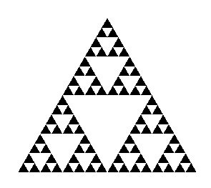
The Sierpinski Gasket
Five subdivisions

Slide 5
The Sierpinski Gasket
GLfloat v[3][2]={{-1.0, -0.58},
{1.0, -0.58}, {0.0, 1.15}};
int n;
void triangle( GLfloat *a, GLfloat *b, GLfloat *c)
/* display one triangle */
{
glVertex2fv(a);
glVertex2fv(b);
glVertex2fv(c);
}

Slide 6
The Sierpinski Gasket
void divide_triangle(GLfloat *a, GLfloat *b, GLfloat *c, int m)
{
point2 v0, v1, v2;
int j;
if(m>0){
for(j=0; j<2; j++) v0[j]=(a[j]+b[j])/2;
for(j=0; j<2; j++) v1[j]=(a[j]+c[j])/2;
for(j=0; j<2; j++) v2[j]=(b[j]+c[j])/2;
divide_triangle(a, v0, v1, m-1);
divide_triangle(c, v1, v2, m-1);
divide_triangle(b, v2, v0, m-1);
}
else(triangle(a,b,c));
}

Slide 7
The Sierpinski Gasket
void display()
{
glClear(GL_COLOR_BUFFER_BIT);
glBegin(GL_TRIANGLES);
divide_triangle(v[0], v[1], v[2], n);
glEnd();
glFlush();
}
void myinit()
{
glMatrixMode(GL_PROJECTION);
glLoadIdentity();
gluOrtho2D(-2.0, 2.0, -2.0, 2.0);
glMatrixMode(GL_MODELVIEW);
glClearColor (1.0, 1.0, 1.0,1.0)
glColor3f(0.0,0.0,0.0);
}

Slide 8
The Sierpinski Gasket
int main(int argc, char **argv)
{
n=4;
glutInit(&argc, argv);
glutInitDisplayMode(GLUT_SINGLE|GLUT_RGB);
glutInitWindowSize(500, 500);
glutCreateWindow(“2D Gasket");
glutDisplayFunc(display);
myinit();
glutMainLoop();
}

Slide 9
The Sierpinski Gasket
We can subdivide each of the four faces
Appears as if we remove a solid tetrahedron from the center leaving four smaller tetrahedra

Slide 10
The Sierpinski Gasket
void triangle( GLfloat *a, GLfloat *b, GLfloat *c){
glVertex3fv(a);
glVertex3fv(b);
glVertex3fv(c);
}
void tetra(GLfloat *a, GLfloat *b, GLfloat *c, GLfloat *d){
glColor3fv(colors[0]);
triangle(b, d, c);
glColor3fv(colors[1]);
triangle(a, b, c);
glColor3fv(colors[2]);
triangle(a, c, d);
glColor3fv(colors[3]);
triangle(a, d, b);
}

Slide 11
The Sierpinski Gasket
void divide_tetra(GLfloat *a, GLfloat *b, GLfloat *c, GLfloat *d, int m){
GLfloat mid[6][3];
int j;
if(m>0) {
for(j=0; j<3; j++) mid[0][j]=(a[j]+b[j])/2;
…………………………………………….
divide_tetra(a, mid[0], mid[1], mid[2], m-1);
…………………………………………….
}
else(tetra(a,b,c,d)); /* draw tetrahedron at end of recursion */
}

Slide 12
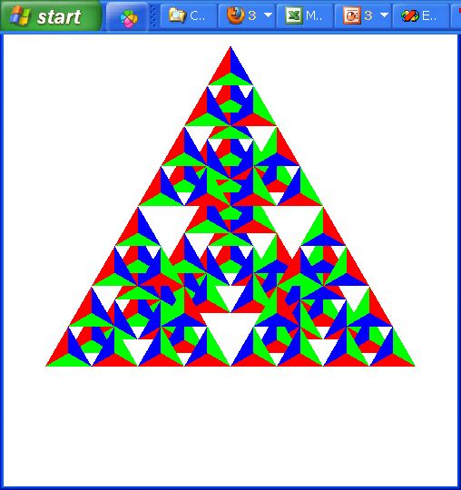
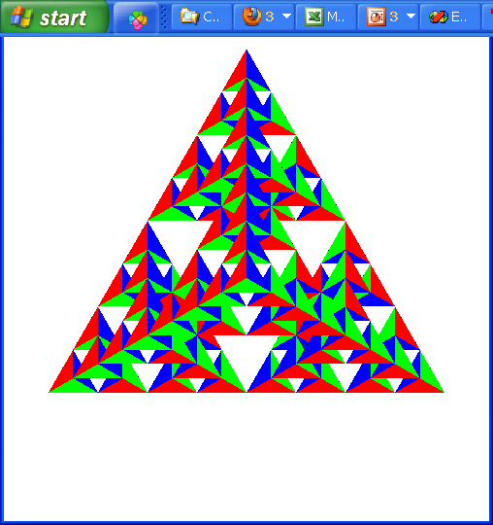
The Sierpinski Gasket
Because the triangles are drawn in the order they are defined in the program, the front triangles are not always rendered in front of triangles behind them

Slide 13
Hidden-Surface Removal

Slide 14
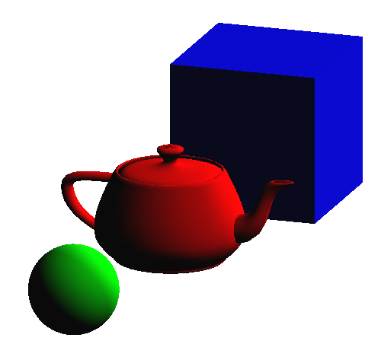
Hidden-Surface Removal
Camera : (0, 0, 20)
Teapot : (0, 0, -1)
Sphere: (0, 0, 1)
Cube: (0, 0, -3)
Correct Order: Camera→Sphere→Teapot→Cube
Draw Order : Teapot→Sphere → Cube

Slide 15
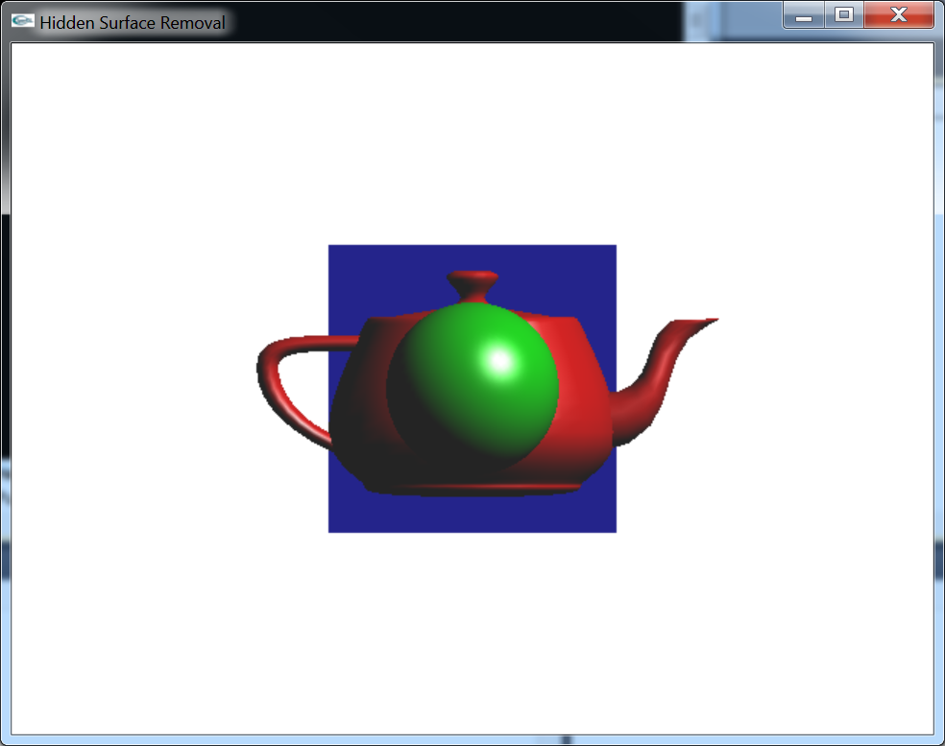
Hidden-Surface Removal
Use Depth Buffer

Slide 16
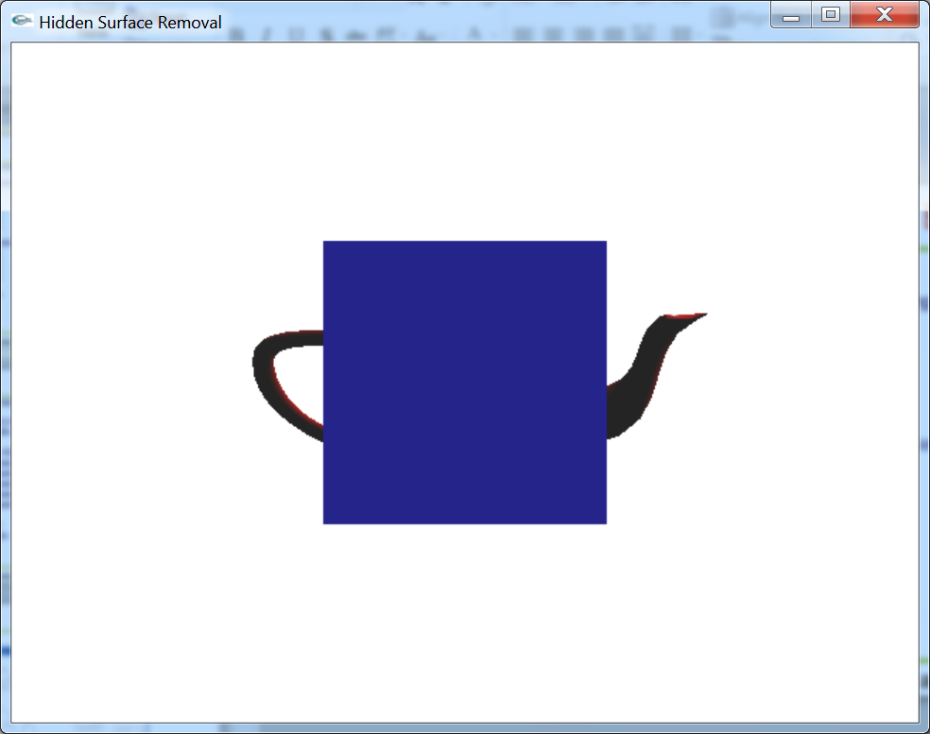
Hidden-Surface Removal
Don’t use depth buffer

Slide 17
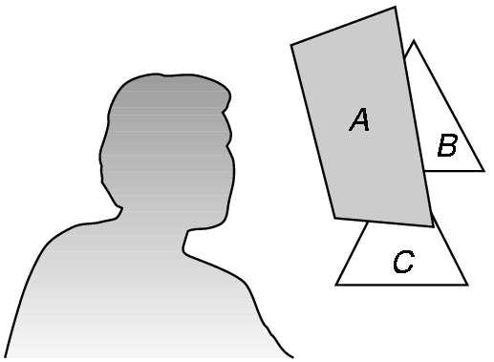
Hidden-Surface Removal
We want to see only those surfaces in front of other surfaces
OpenGL uses a hidden-surface method called the z-buffer algorithm that saves depth information as objects are rendered so that only the front objects appear in the image

Slide 18
Hidden-Surface Removal
The algorithm uses an extra buffer, the z-buffer, to store depth information as geometry travels down the pipeline
It must be
Requested in main()
glutInitDisplayMode(GLUT_SINGLE | GLUT_RGB | GLUT_DEPTH)
Enabled
glEnable(GL_DEPTH_TEST)
Cleared in the display callback
glClear(GL_COLOR_BUFFER_BIT |
GL_DEPTH_BUFFER_BIT)

Slide 19
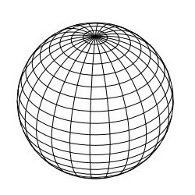
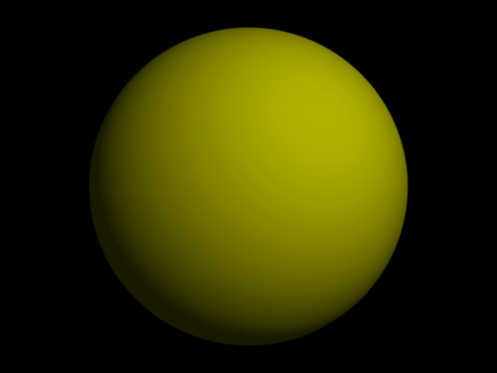
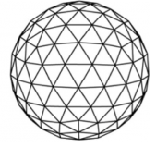
Modeling Sphere

Slide 20
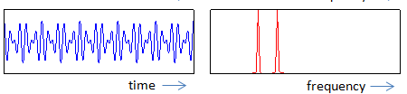

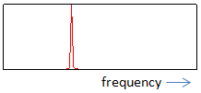
Modeling Sphere

Slide 21
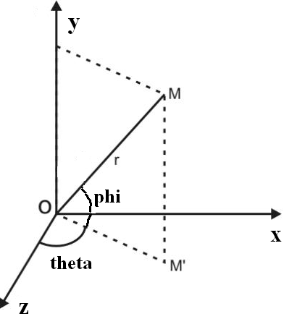
Modeling Sphere
Spherical coordinate system
x = r*sin(theta)*cos(phi);
z = r*cos(theta)*cos(phi);
y = r*sin(phi);

Slide 22
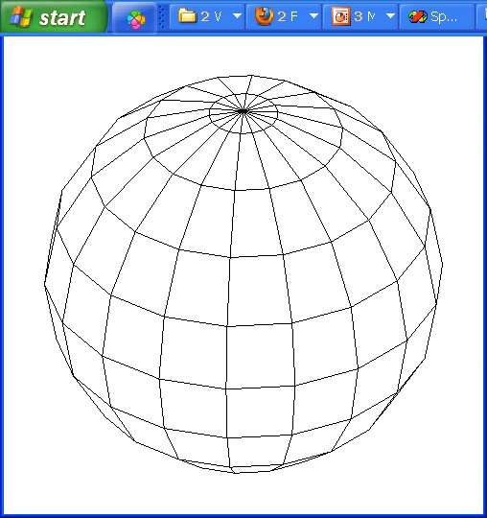
Modeling Sphere
Phi : -90 → 90
Theta: 0 → 360
Theta: -180 → 180

Slide 23
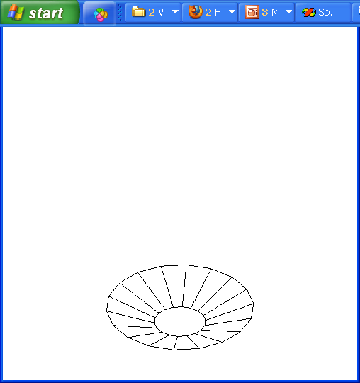
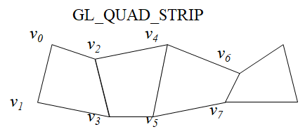
Modeling Sphere

Slide 24
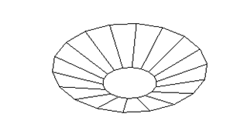
Modeling Sphere
for(float phi = -80; phi<=80; phi+=20){
phir = c*phi;
phir20 = c*(phi+20);
glBegin(GL_QUAD_STRIP);
for(float theta = -180; theta<=180; theta+=20) {
thetar = c*theta;
x = sin(thetar)*cos(phir); z = cos(thetar)*cos(phir);
y = sin(phir);
glVertex3d(x, y, z);
x = sin(thetar)*cos(phir20);z = cos(thetar)*cos(phir20);
y = sin(phir20);
glVertex3d(x, y, z);
}
glEnd();
}

Slide 25
Modeling Sphere
glBegin(GL_TRIANGLE_FAN);
glVertex3d(0, 1, 0);
c80 = c*80;
y = sin(c80);
for(float theta = 180; theta>=-180; theta-=20)
{
thetar = c*theta;
x = sin(thetar)*cos(c80);
z = cos(thetar)*cos(c80);
glVertex3d(x, y, z);
}
glEnd();

Slide 26
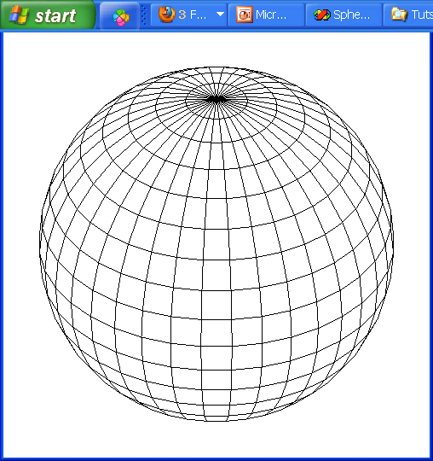
Modeling Sphere

Slide 27
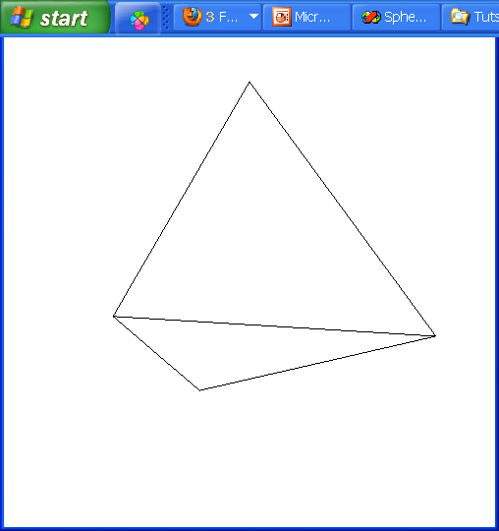
Modeling Sphere

Slide 28
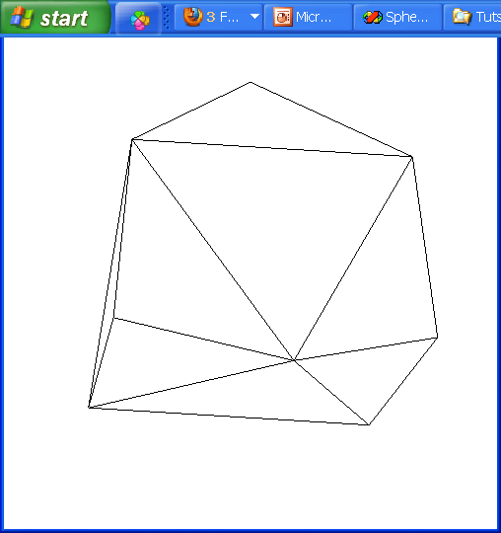
Modeling Sphere

Slide 29
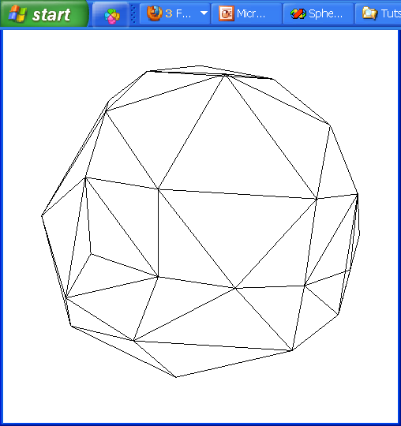
Modeling Sphere

Slide 30
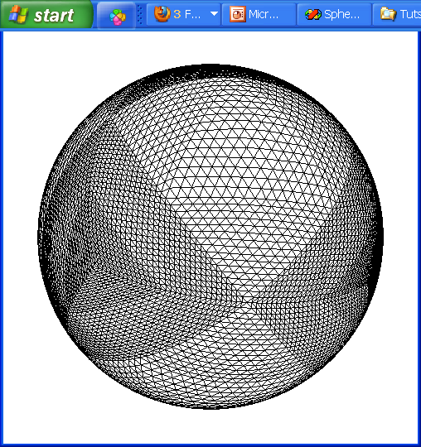
Modeling Sphere

Slide 31
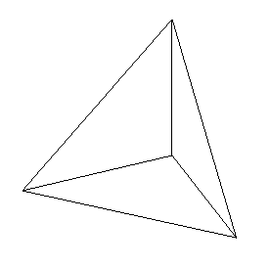
Data Structure
GLfloat a[3] = { 0, 0, 0 },b[3] = { 1, 0, 0 };
GLfloat c[3] = { 0, 1, 0 },d[3] = { 0, 0, 1 };
glPolygonMode(GL_FRONT_AND_BACK, GL_LINE);
glBegin(GL_TRIANGLES);
glVertex3fv(a);glVertex3fv(b);glVertex3fv(c);
glVertex3fv(a); glVertex3fv(b); glVertex3fv(d);
glVertex3fv(a); glVertex3fv(c); glVertex3fv(d);
glVertex3fv(b); glVertex3fv(c); glVertex3fv(d);
glEnd();
Y
c
a
d
b
Z
X

Slide 32
Data Structure
struct Face {
int numVerts;
Point3D *pointArr;
};
class Mesh {
int numFaces;
Face *faceArr;
void DrawWireframe() ;
void DrawColor();
};

Slide 33
Modeling Shapes with Polygonal Meshes
Defining a Polygonal Mesh
- A more efficient approach uses three separate lists : a vertex list, a normal list, and a face list
- The three lists work together : The vertex list contains locational or geometric information, the normal list contains orientation information, and the face list contains connectivity or topological information.

Slide 34
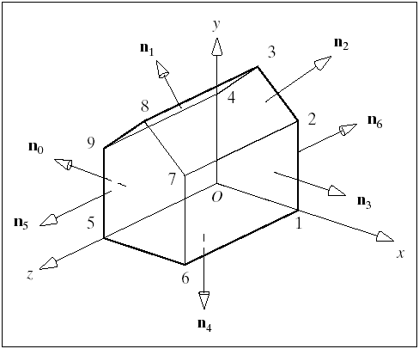
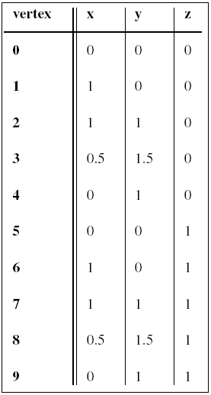
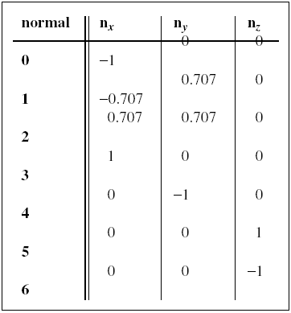
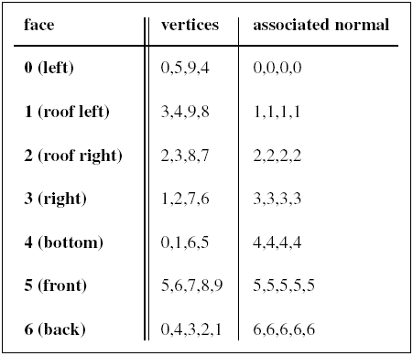
Modeling Shapes with Polygonal Meshes

Slide 35
Modeling Shapes with Polygonal Meshes
class VertexID{
public:
int vertIndex; //index of this vertex in the vertex list
int normIndex; // index of this vertex's normal
};
class Face{
public:
int nVerts; // number of vertice in this face
VertexID* vert; // the list of vertex and normal index
Face() { nVerts = 0; vert = NULL; }
~Face() { delete[] vert; nVerts = 0; }
};

Slide 36
Modeling Shapes with Polygonal Meshes
class Mesh {
private:
int numVerts; // number of vertices in the mesh
Point3* pt; // array of 3D vertices
int numNormals; // number of normal vectors for the mesh
Vector3* norm; // array of normals
int numFaces; // number of faces in the mesh
Face* face; // array of face data
// ... others to be added later
public:
Mesh();
~Mesh();
// ... others
};

Slide 37
Modeling Shapes with Polygonal Meshes
void Mesh::DrawWireframe(){
glPolygonMode(GL_FRONT_AND_BACK, GL_LINE);
for (int f = 0; f < numFaces; f++) {
glBegin(GL_POLYGON);
for (int v = 0; v < face[f].nVerts; v++){
int iv = face[f].vert[v].vertIndex;
glVertex3f(pt[iv].x, pt[iv].y, pt[iv].z);
}
glEnd();
}
}

Slide 38
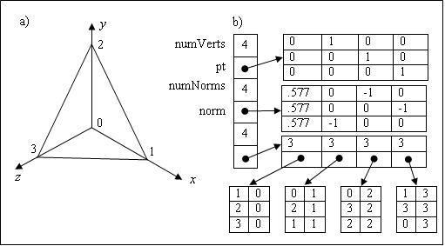
Modeling Shapes with Polygonal Meshes

Slide 39
Modeling Shapes with Polygonal Meshes
void Mesh::CreateTetrahedron()
{
numVerts=4;
pt = new Point3[numVerts];
pt[0].set(0, 0, 0);
pt[1].set(1, 0, 0);
pt[2].set(0, 1, 0);
pt[3].set(0, 0, 1);

Slide 40
Modeling Shapes with Polygonal Meshes
numFaces= 4;
face = new Face[numFaces];
face[0].nVerts = 3;
face[0].vert = new VertexID[face[0].nVerts];
face[0].vert[0].vertIndex = 1;
face[0].vert[1].vertIndex = 2;
face[0].vert[2].vertIndex = 3;
face[0].vert[0].normIndex = 0;
face[0].vert[1].normIndex = 0;
face[0].vert[2].normIndex = 0;

